Slide 1
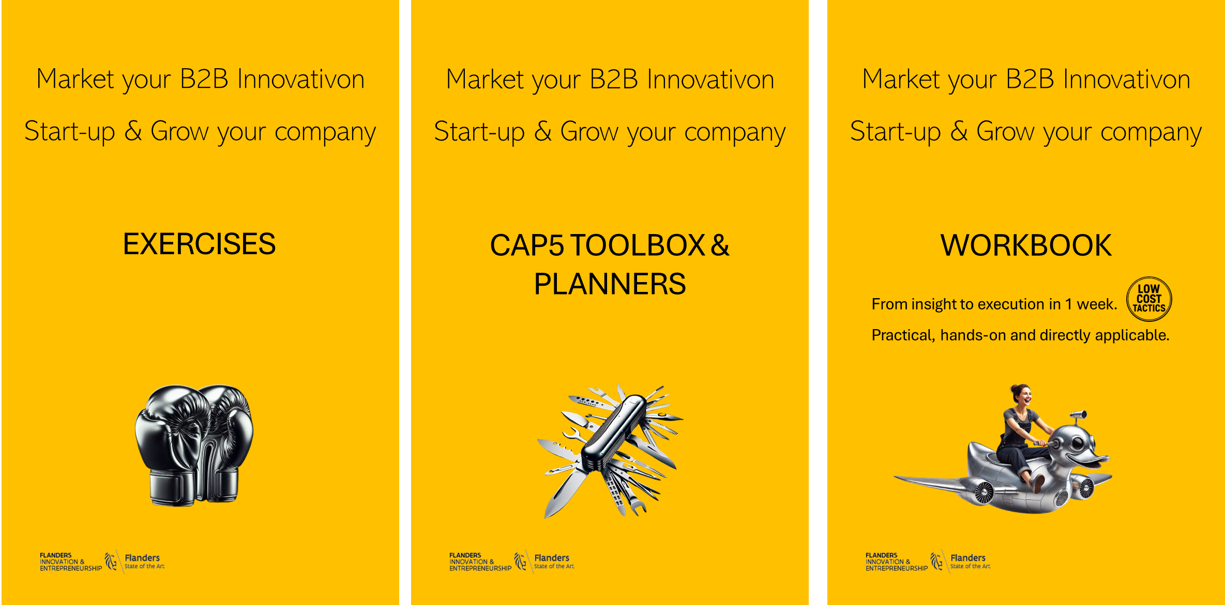
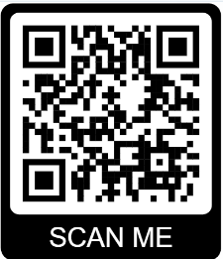

B2B Innovation Workbook Exercises
More downloads
www.CAP5.net

Slide 2


Only do the exercises that are relevant for you.
Only fill in where you think it will help you.
Exercises help you to understand, see clear and in context, and allow you to make a sharp and smart strategy, tactics and communications

Slide 3
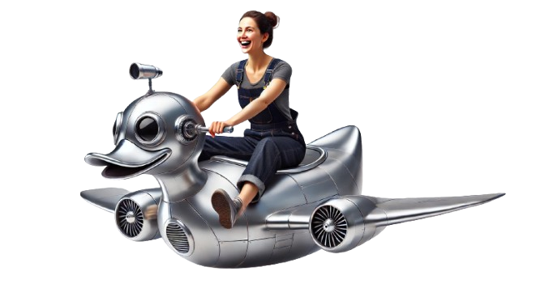
INSIGHTS

Slide 4

Your most opportune market segments analysis
Market Segment or niche:
Identify opportune audiences and/or niches where you can best succeed. Validate whether the target groups or niches are also profitable. This exercise should enable you to launch your innovation is ‘warm’ market segments or niches.
PAINS Solving Pains & Frustrations | Which problems can your innovation solve better than the alternatives | Do you have a ready-made solution for these needs or problems they have? | List some possible customers where you can solve their problems well | Describe your preferred customer pains and how it influences their operations or capacity
GAINS Making ambitions possible | Where can your innovation add tangible value? | Where can you enable the needs and ambitions of companies? | List possible customers where you can solve their problems well | List customers that ‘GAIN’ much from your innovation
Op www.cap5.net free downloaad
Only fill in what is relevant for you. Modify template if needed.

Slide 5
Direct Market, Segment & Niche Analysis
Market Segment: Dental care centres
 | Industy Market - Sector | Market Segment | Market Niche
Name & define your target groups: Still growing, stable, declining? Why?
Estimated size in targeted regions. Estimated potential customers + estimated average revenu per customer can be made.
What do target people use now to solve the issues? What is the approximity/average cost for solving this issue now?
What technologies, solutions will become dominant the next 3-5 years?
Mayor risks (regulations, compliance, accreditations needed, ..) or barriers of entry to enter?
Which locations / regions / segments should we target first?
How many mayors players (potential competitors) are still active here?
List the ‘probable’ stiffest competitors in your targeted segments
Op www.cap5.net free downloaad
Only fill in what is relevant for you. Modify template if needed.

Slide 6
Direct Rival Analysis – Top 3
Market Segment: Dental care centres
 | Rival 1: OxyHaleine | Rival 2: xx | Rival 3: xx
Estimated % market size of rival. How many years are they active in segment? Are they active in other segments?
What resembles the their solution versus yours? What set’s your solution apart?
Why do customers buy from them? What are their strengths?
What is their Product & Service offering to these sectors? Do they have unique selling strong points?
Mode of operation? Through resellers, partners, branches, eCommerce, ..
Do they have strategic partners in order to sell to these sectors? Or strategic partners that give them extra mileage?
What incentives do they use?
What payment plans / facilities do they offer?
Op www.cap5.net free downloaad
Only fill in what is relevant for you. Modify template if needed.

Slide 7
Competitors positioning and mode of operations – per target region
Market Segment: Dental care centres
We focus on main rivels. However, in some sectors there might be many more competitors
 | Region 1: Flanders | Region 2: The Netherlands | Region 3: Luxenbourg
Top 3 main competitors
What percentage (estimated) of target customers use their solution?
Do they offer product or service as a stand-alone or as a packaged solution?
Product & Service offering. List the options they give to customers?
Mode of operation? Through resellers, partners, branches, eCommerce, training sessions, ..
What incentives do they use?
Op www.cap5.net free downloaad
Only fill in what is relevant for you. Modify template if needed.

Slide 8

Main competitor analysis
Name of main competitor (rival):
Local of foreign owned?
Location Headquarters:
Location Local / National Office:
Annual turn-over:
Number of staff world:
Number of staff Belgium:
Main products and/or services (core business):
Which segments do they target?
For which expertise / products are they known in sector?
What offers do they make?
USP: what is/are their uniques strengths?
Which elements of their offers leaves room for improvement?
Where are their shortcomings? Do they have a weak spot?
What is their slogan?
Which products or services (names) do they have in your target maket?
What incentives / special offers to they give?
What is their value proposition?
How strong & aggressive are they in your target markets?
Where and how can you lure their customers to your innovation?
Do they have strategic partners in Belgium?
Do they have resellers, franchise, branches, independent salespeople, ..?
Op www.cap5.net free downloaad

Slide 9
Direct & Indirect competitor positioning - Matrix
Competitor analysis matrix : Direct Competitors
Competitor analysis matrix : Indirecte Competitors
Direct competitors; Same target group, same solution, same type of products or service
Indirect competitors; same target group but have an alternative solution to the same problem
High / Strong
Challengers (Small players but with strong growth)
Leaders (dominant market position))
High / Strong
Challengers (Small players but with strong growth)
Leaders (dominant market position))
Product B
Product D
Product B
Product F
Product C
Product D
Product C
Product A
Same or very similar products / services
Solutions for the same problems, pains, needs
Product E
Product G
Product H
Product A
Small specialized, local niche players
One or few products / service in many different segments
Zwak
Small specialized, local niche players
One or few products / service in many different segments
Market share
Market share
Op www.cap5.net free downloaad

Slide 10
Overview of possible partners, resellers & distributors
Please complete the table below – per business segment
Segment | Region | Partner | Reseller / Francise | Distributor
Product X
Product Y
Product ..
Op www.cap5.net free downloaad
Only fill in what is relevant for you. Modify template if needed.

Slide 11
What partners & resellers want?
 |  | Needs: what they demand to become a partner. Minimum requirements |  | Wants | Wants: what they additionally like and would make you a preferred partner or suppler
Partners | A =
 | B =
 | C =
Resellers | A =
 | B =
 | C =
Op www.cap5.net free downloaad
Only fill in what is relevant for you. Modify template if needed.

Slide 12
Strategic positioning of price – Purchase Price
Intelligent Pricing matrix Competitors will have different price strategies. The comparison should be made on a similar / comparable offer as yours. You might consider lifespan factor of product and residual value.
Price as compared to competitors in the market. | Highest
 | Same
 | Lowest
 |  | Worst | Same | Best
Op www.cap5.net free downloaad
Only fill in what is relevant for you. Modify template if needed.

Slide 13
Strategic positioning of price – Rental / Leasing Price – per month
Intelligent Pricing matrix Competitors will have different price strategies. The comparison should be made on a similar / comparable offer as yours. You might consider rest or residual value after the lease opion.
Price as compared to competitors in the market. | Highest
 | Same
 | Lowest
 |  | Worst | Same | Best
Op www.cap5.net free downloaad
Only fill in what is relevant for you. Modify template if needed.

Slide 14
What main factors will drive your business?
1 | Category | Main business drivers | Explain
2 | Legislation | Accredited, licensed, fully compliance, new sector norms, new ecological standards?
3 | Quality | Reliability and longevity perceived by customers.
4 | Risk reduction | Customers perceive it will reduce risks or avoid bottle-necks.
5 | Productivity | It will boost the customers’ productivity, more output, opportunity to attract bigger clients.
6 | Cost | It will lower the customer’s operating, service costs.
7 | Prestige | It will provide prestige and accreditation to the customer. It will enhance the brand and management. They will getextra-business accreditation.
8 | Dependency | Your product or service is an integrated, complementary service to an existing, established product or service.
9 | Attractiveness to resellers | Resellers determine largely your sales volumes.
10 | Influencers | Influencers, strategic partners and networkers will be your main sales-weapon.
Op www.cap5.net free downloaad
Only fill in what is relevant for you. Modify template if needed.

Slide 15
SWOT analysis: exploit strengths, disguise shortcomings
STRENGTHS | WEAKNESSES | OPPORTUNITIES | THREATS
Your clear, tangible, quite unique strong points | What are your shortcomings to win it from competitors? | Where are the gaps in the target segments where you can make a tangible difference? | What could or will likely be a threat to your product, solution or innovation?
How can you exploit your strengths? | How can you compensate, camouflage your shortcomings? What do you have to do to resolve your shortcomings? | Which niches are not well serviced by competitors? Do customer complains about still having issues with the current solutions? | How serious are these threats and what can you do to lower these threats?
Op www.cap5.net free downloaad
Only fill in what is relevant for you. Modify template if needed.

Slide 16
Pains & Gains analysis, per decion maker profile
 | HR applicatie voor grote KMO’s, consultancy en nutsbedrijven. | Procurement & compliance officer | COO & Production Manager | Head of IT or Network Architect | Chief Engineer | Chief Finance | CEO and Board | Legal / compliance
Benefit | What’s in it for him or her?
Features | How does your product work. How do you proceed?
Fears | What is the risk of switching to your product or service? What are their concerns when they switch to your product or service?
Hidden | What are the hidden (personal) motives for buying your product or service?
Habits | Are there any habits / protocol that stand in the way of switching to your product or service?
Currently | How does this person views the current solution?
Other solutions | What products/services is the prospect currently buying from competitors or through alternative solutions?
Op www.cap5.net free downloaad
Only fill in what is relevant for you. Modify template if needed.

Slide 17
Low hanging fruit strategy: select your first target customers
Targeted customer: Anesticia & beyond
Do we have local presence?
Are we ready to deliver?
Do we have strong valua propositions?
Targeted customer: ………………………
Do we have local presence?
Are we ready to deliver?
Do we have strong valua propositions?
Targeted customer: ………………………
Do we have local presence?
Are we ready to deliver?
Do we have strong valua propositions?
Targeted customer: ………………………
Do we have local presence?
Are we ready to deliver?
Do we have strong valua propositions?
Targeted customer: ………………………
Do we have local presence?
Are we ready to deliver?
Do we have strong valua propositions?
Op www.cap5.net free downloaad
Only fill in what is relevant for you. Modify template if needed.

Slide 18
Preferred Clients shortlist, early & medium term
 | Strategic Customers | High End Customers | Medium | Light customers
Sector / Niche / Location: Early (e.g.) first 2 years Later (e.g.): + 2 years
Sector / Niche / Location: Early (e.g.) first 2 years Later (e.g.): + 2 years
Sector / Niche / Location: Early (e.g.) first 2 years Later (e.g.): + 2 years
Make a list of customers you would love to get.
Op www.cap5.net free downloaad
Only fill in what is relevant for you. Modify template if needed.

Slide 19
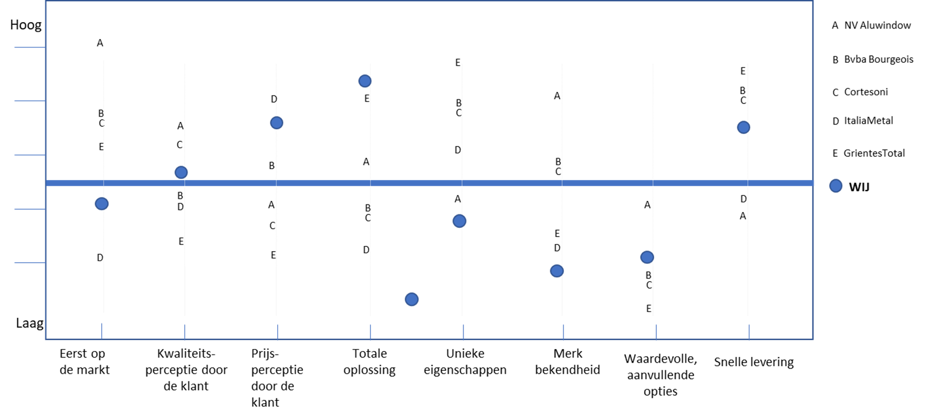
Client perception matrix
Op www.cap5.net free downloaad
Only fill in what is relevant for you. Modify template if needed.

Slide 20
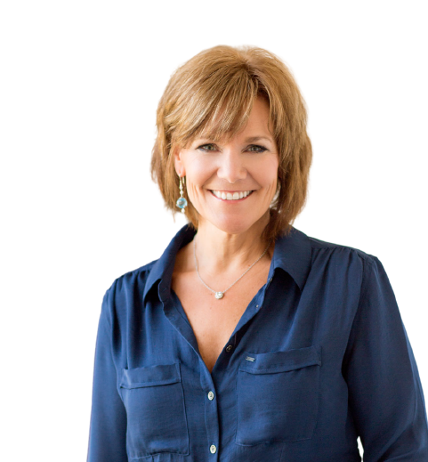
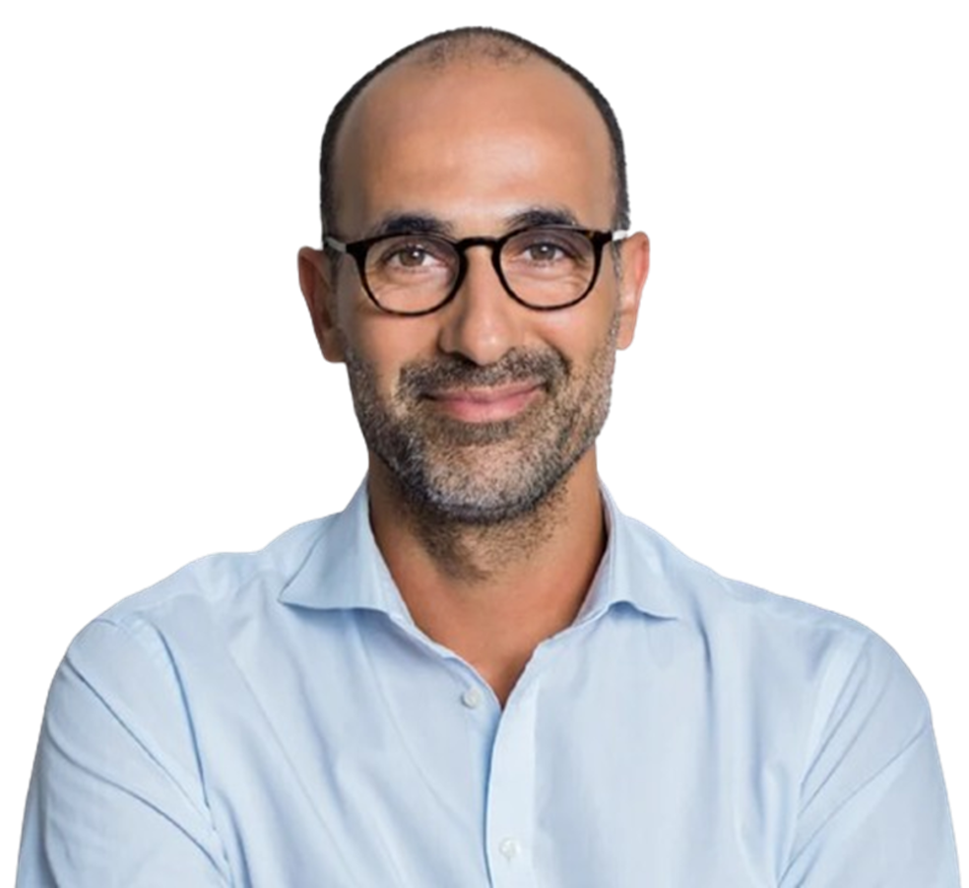
Target Audience profiling
Buyer Profile: HR Directors
Make this exercise for each of your preferred potential customer’s profile
Demographic What segments : What is her family status: Age brackets: Her / his studies? | His / her critical pain points? | How he or she is solving problems now?
His / Her personal objectives? | Why would she be interested in our innovation? | Which specific pains / frustrations / challenges can we solve well?
His / Her preferred form and channel of communiations? How can we reach her? | Who are the other procurement decision makers with regards to buying our innovation? | What other features of your service or product are important to him / her?
How would they prefer to pay for it? | What they are possible breaking points or barriers. | Where does they get information? Do they follow influencers / sector experts / channels? Do we know people around her?
What’s the best manner and time to pitch our innovation? What events do they visit? | With what slogan & materials can he / she convince the other decision makers? | On which social media is he / she active? Is it active in working groups, study groups?
Op www.cap5.net free downloaad
Only fill in what is relevant for you. Modify template if needed.

Slide 21
Decision makers in typical decision process
Market Segment: Operating theater (OT) equipment and infrastructure
Roles | Involved in decision process? | Important elements in communication | USP Unique selling points: what has added value and is important | ESP An emotion that resonates with their pain points | How we can reach them
End user | No. OK anesthesists, surgeons | Health, testimonials from other doctors, more pleasant work, less stress, less chance of errors | Combination of source extraction and OR room extraction interactive = optimal environment, high precision, .. | More pleasant, better in skin, better precision, no mistakes, no discomfort, healthier | Hospitals.be, Tijdschrift voor Geneeskunde en Gezondheidszorg (TvGG), AZ Klina magazine
Direct beneficiaries | No. Nurses, cleaning staff | More pleasant working environment, health, less stress, better ambiance between doctors and staff, less danger | Clean air = better health | Fresher, more pleasant, less discomfort, healthier
IT Approval | Yes. IT support, CTO & IT architect must approvove | Personal data security | Plug & play and ownership by client |  | One pager info “showing what to be done”, easy steps, tech specs, Q&A, hot-line for questions
Technical approval | No. | Joint installation done. Only help for the connection to mainframe computer is needed |  |  | Our installation people will hand over procedure and timing sheet
Financial Approval | Yes. Monthly leasing or renting proposition. |  | Cost leasing & rental is only 15% of immediate gains Cost can be invoiced - per operation. | Smart investment with positive ROI | One page finance fact sheet with options
Budget Approval, Head of Division | Yes. He or she will ultimately decide. He or she will raise a procurement request. |  |  | Less absenteeisme among staff, Less workload. Staff is happier. | Testimonials, test-results & case studies in other hospitals
Strategic Approval (Head of Division, CEO, MD) | Less 8000 euro, not needed + 8000 euro, CEO + CFO need to approve. | Risk reduction contamination, ROI, lowering staff absenteeisme, doctors happier | Become one of first hospitals to provide “top healthy OK” in Belgium. Great to attract top doctors. | Hospital becomes ‘Great place to work’, less absenteeisme among staff, less reputation risks, smart investment
Compliance & Operational Approval | Yes. ISO and EU credentials to be submitted | All requirements must be OK. Installation without any disruption to the operating theaters. |  | Good reputation, no reputation damage (1.5% avoidable professional errors)
Op www.cap5.net free downloaad
Only fill in what is relevant for you. Modify template if needed.

Slide 22
Relevant trends that could disrupt your innovation
Market Segment:
Op www.cap5.net free downloaad
Only fill in what is relevant for you. Modify template if needed.

Slide 23
STRATEGY

Slide 24
Value Proposition Aid
Market Segment: XXXXXXXX
Op www.cap5.net free downloaad
Only fill in what is relevant for you. Modify template if needed.

Slide 25
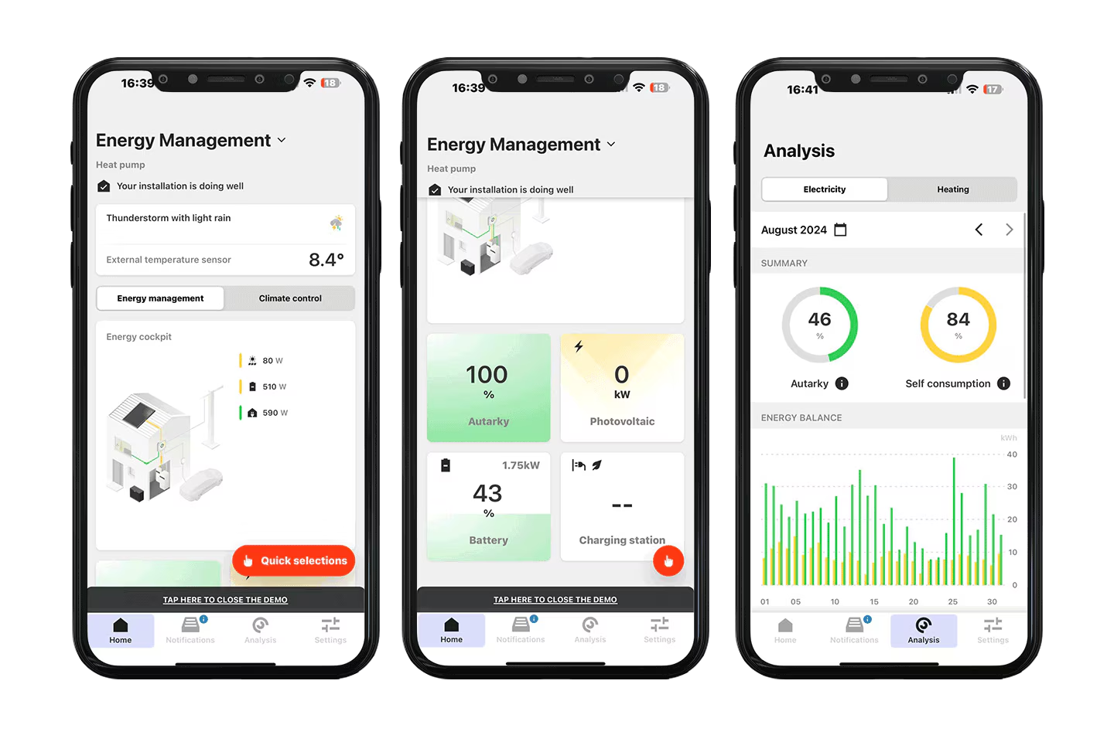
USP, Value Proposition, Slogan, Elevator Pitch
Market Segment: Agriculture, greenhouse cultivation
Elevator Pitch: Why are solution is better, more reliable than the alternatives:
Our value proposition:
This is what customers will achieve with our solution: Cut down on energy costs by as much as 25% | These our the features, method, .. Why our solution is better placed to solve the target audience problems and challenges. | Our slogan: Join the companies that don’t want to pay anymore for wasted energy! Cut down your energy bills by as much as 20%
The key to our success is: More and more companies use our digital app to manage their energy more intelligently in order to avoid waste and reduce the monthly energy bills. | Why is our offer more suited for our target companies? What options can they choose from? Light: switch-off energy with dedicated time-zones Medium: intelligent energy management with senors, manageble from a distance through our app. Premium: fully outsource energy management with sensor and AI intelligence. | Our Elevator Pitch: Give us three days and you’ll never pay anymore for wasted energy! We need one day to install sensors and smart switches. We set parameters to your specifications. We’ll train you on the app for half a day and any day after you start saving money. We can rent this solution so it doens’t cost you anything and you save quite a lot of money.
That's why we can keep our ambitious growth in the coming 5 years: Energy costs keep rising. Company want to reduce waste, CO2 and lower their bills. We have the most easy and peace-of-mind solution on the market | How we support and engage with our customers from day one till long after:
Op www.cap5.net free downloaad
Only fill in what is relevant for you. Modify template if needed.

Slide 26



Pricing strategy at launch versus top 3 rivals
Market Segment: XXXXXXXX Before launching our innovation, phase 1
Low
Medium
High
Purchase price:
Rental cost / month:
Leasing cost / month:
Total cost of ownership (incl. installation): 36 months
Total cost of ownership (incl. procurent + installation + residual value): 60 months
Product launch price
For first 5 customers
Our top 3 rivals
That’s us
Solaire
ComfyT
AlwaysWarm
Op www.cap5.net free downloaad

Slide 27
Pricing strategy versus top 3 rivals
Market Segment: XXXXXXXX Pricing strategy after launch
Higher price
 | HIGHER | MEDIUM | LOW
HIGH
MEDIUM
LOW
Higher Quality
Premuim product, premium priced
average
Cheap & Low quality
Op www.cap5.net free downloaad
Only fill in what is relevant for you. Modify template if needed.

Slide 28
Pricing strategy resellers
Market Segment: XXXXXXXX Country / Region:
Segment | Possible Resellers | Years active | Exclusive? | % marging & volume discounts / incentives | Short-selected?
Region: ……………………… | * * * *
Region: ……………………… | * * * *
Region: ……………………… | * * * *
Region: ……………………… | * * * *
Op www.cap5.net free downloaad
Only fill in what is relevant for you. Modify template if needed.

Slide 29
Upselling & Cross-selling opportunities
 |  | Product / Service: | Product / Service: | Product / Service:
UP SELLING Same product → more expensive/advanced version | Can we offer an upgrade / premium option when customer decides?
 | What?:
CROSS-SELLING Different product → complements main purchase | Can we encouraging the customer to buy additional, complementary products or services alongside their current purchase?
 | What?:
Op www.cap5.net free downloaad
Only fill in what is relevant for you. Modify template if needed.

Slide 30
Corporate goal and objectiven end of Y1, Y3 and Y5
 |  | End of year 1 | End of year 3 | End of year 5
Number of resellers |  | 3 | 9 | 18
Number of distributors |  | 1 | 5 | 6
Annual number of sold items - Light | Less than 2400 EURO | 6 | 30 | 70
Annual number of sold items – Medium | 2401 – 3600 EURO | 2 | 26 | 50
Annual number of sold items – Premium | 3601 – 5800 EURO |  | 10 | 25
Number of lease or rental contracts 36 months |  | 3 | 12 | 20
Number of lease or rental contracts 72 months |  | 2 | 8 | 15
Sales revenue growth, annual increment |  |  |  | 18%
Number items product portfolio growth |  | 1 | 3 | 4
Profit before taxes
Op www.cap5.net free downloaad
Only fill in what is relevant for you. Modify template if needed.

Slide 31
Corporate goal and objectiven end of Y1, Y3 and Y5
Each business is a biotope with individuality, recognizable starvings, values and ambitions. A good thing is contemporary, has a distinct character. Your vision is the compass. Your personality should bind customers. Try to fill in this canvas with short sentences.
Who are we? | What are we good at? | Who are we doing it for? | What drives us to do this every day?
Why are we going to make a difference? | Why are we "cool"? | What do we want to achieve in the next 2 years? | What do we want to achieve in the next 5 years?
Op www.cap5.net free downloaad
Only fill in what is relevant for you. Modify template if needed.

Slide 32
Elevator pitch & value proposition
Elevator Pitch: For which we have a unique solution:
Our value proposition:
This is what customers can achieve with our solution: | We will be recognised for:
This is the key to our success: | Why is our approach better/more complete than the one of our competitors:
That's why we see a growing demand for our products: | How we can advise our clients during the decision-making process:
Op www.cap5.net free downloaad
Only fill in what is relevant for you. Modify template if needed.

Slide 33
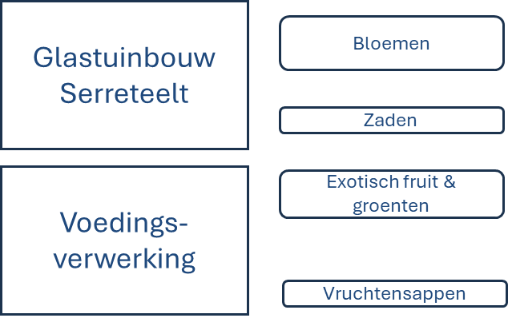
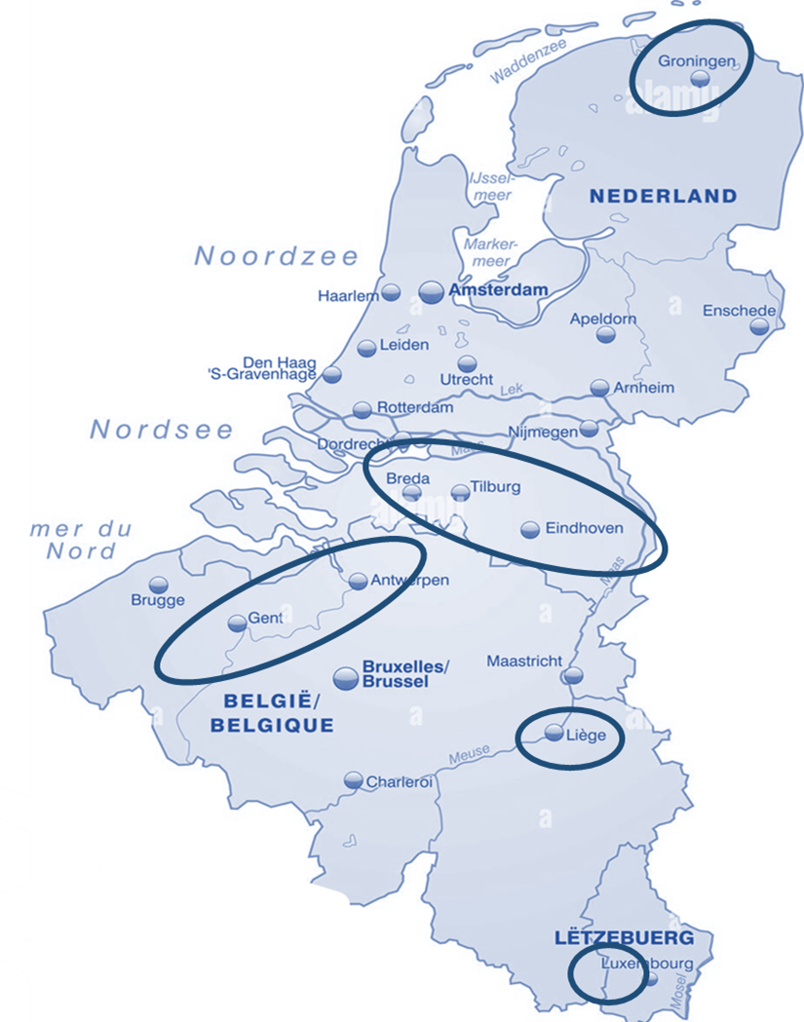
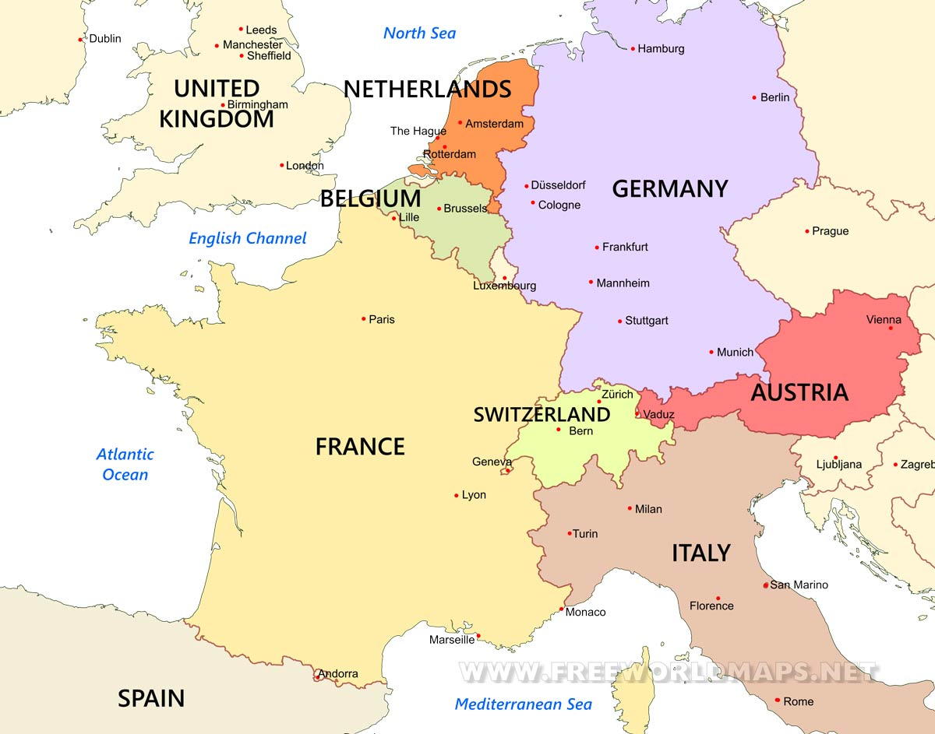
Where & how we’ll sell
We sell direct
We sell though Resellers
cty | Reseller
France | LeClerck – confirmed
Germany | Bunschauffen
Austria | Lauda - confirmed
Italy | Berlotti Inc
UK | Tech Brothers
Switzerland | tba
Op www.cap5.net free downloaad

Slide 34
Recognizably & distinct different:
Challenging programs that are unique in the world. Many would love, few are chosen so we’re looking for something mystical, distinct like a freemasonry for wisdom-hunters.
Based on strong why:
A few valuable competences allows you to get more fulfillment and get better results in life and work
A story people can tell:
They teach you valuable competences during a challenging, adventurous program so you get more joy and results in leadership. They give you a work / life blending recipe so there is more fun being a leader.
Strong brands creates clarity:
A number of competences can change much in the way you’ll get results and fulfillment in leadership.
Distinct assets:
Tangible approach
Immediately applicable
Longevity
Something people dream about
Privilege to participate
Brand promise:
We’ll teach you valuable competences that you can mould into your own methods you can apply immediately.
We make people’s dreams possible and we will also give them life-changing skills.
A living brand:
Participants become members of I’SPYRE and remain followers of the I’SPYRE community and activities. Participants opt voor seasonal and annual events.
Pains:
SME leaders are tired because they find it hard to delegate and trust subordinates
SME leaders do not fully exploit the organisatonal capacity
Gains:
SME leaders are happier because they have a better work / life blend
SME are more successful because they delegate better and trust subordinates
SME leaders optimise better the organisatonal potential
How to become trustworthy:
I’SPYRE is run by accredited partners.
I’SPYRE has distinguished executive ambassadors.
Government agencies promote the scheme / brand.
KMO portefeuille is awarded (40% reimbursement).
Distinguished people praise the brand. & endorse the formulae.
Participants endorse the program and become ambassadors.
Op www.cap5.net free downloaad

Slide 35
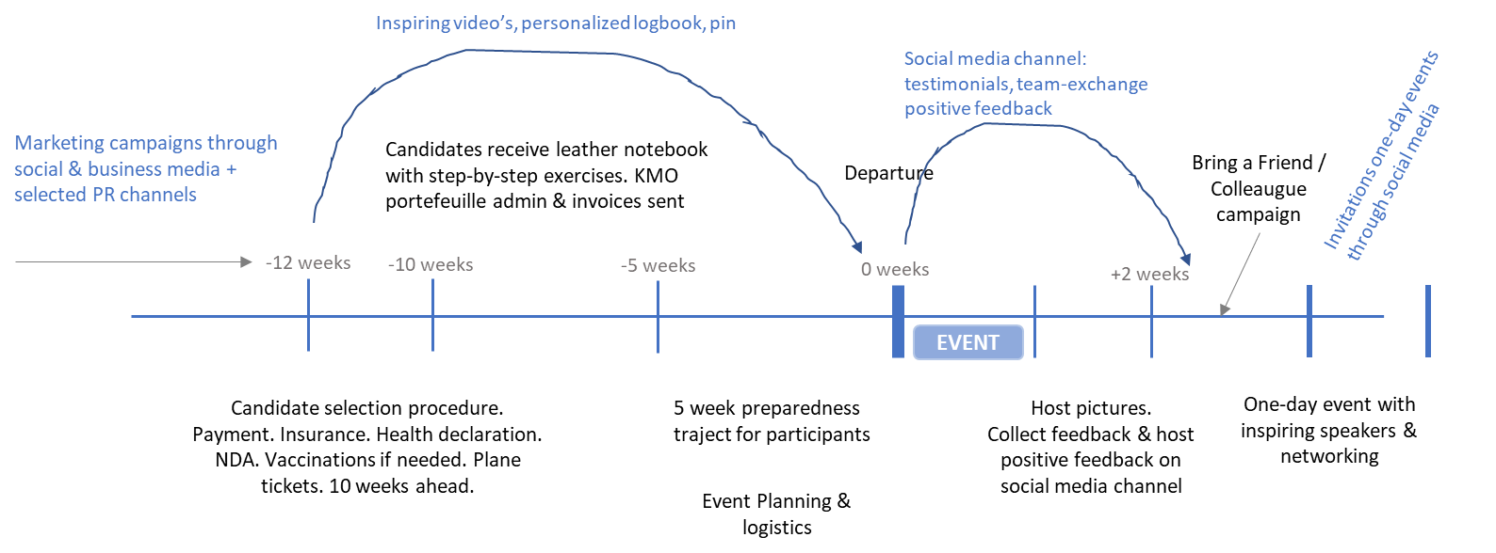
Business model Canvas, I’SYPRE , V1
KEY PARTNERS:
Founder; Bart Peeters, CAP5, www.cap5.net, www.ispyre.net
Logistics & coordination: Made in Africa Tours, contact Richard White, https://www.madeinafricatours.com/
Wildlife Partner: Journey Wild, The Wild Walk, Mark Tennant http://www.journeywild.co.za/
EcoTraining: EcoTraining is the pioneer and leader in safari guide and wildlife training in Africa. https://www.ecotraining.co.za/
KEY ACTIVITIES:
Adventures that blend extraordinary experiences with inspiring people who teaches valuable ldeadership skills.
VALUE PROPOSITIONS:
KENDRY; You will be a better, happier leader
Makya; You will return with skills allowing you to better detect and hunt opportunities
ZEID; Young potentials have extra skills that maximize their potential and keep them happier in their job
CUSTOMER RELATIONSHIPS:
Loyalty program largely autonomous but where inspiring video’s & best-practices are shared + seasonal events organised
CUSTOMER LOYALTY PROGRAM:
The loyalty plan is only for the leadership skills traject. It allows you to add credits.
Five modules:
Decisiveness & people empowerment
Empathic listening & comms skills
Build & Orchestrate
Plan & Tactics
Enjoy the leadership ride
KEY RESOURCES:
8 week prep toolkit that contains self-assessment exercises and selected videos of inspiring people about leadership skills and the quest for work/life blending
CHANNELS:
SEA: Linkedin, FB campaigns
PR & networking: through government agencies, business forums (VOKA, Exclusive service groups, ..). Through PR moments (presentations)
REVENUE STREAMS:
Income: Participants (of his/her employer’s) fee.
Spin off consulting – CAP5 ad hoc assignments + exposure
Spin off holidays / Corporate incentive travel - MadeInAfricaTours
CUSTOMER RELATIONSHIP:
Op www.cap5.net free downloaad

Slide 36





2023
2024
2025
2025-2030
Main objectives | Main objectives | Main objectives | Main objectives
Op www.cap5.net free downloaad

Slide 37
TACTICS

Slide 38
Sales Tactics to outfox top 3 rivals – unique offers
 | We’re better in | BonMartre | GermanManu | HillBoy
Best pricing, rental & leasing. Contract means installation and maintenance included = total peace of mind. We’re the only once to do this. | Best pricing in rental & leasing | 14% more expensive | 24% more expensive | 8% more expensive
Engineers on stand-by with hotline 7/7. Monthly webinars by our technical staff, online very good Q&A | We’re always on stand-by | 5/7 only. Not hotline | 5/7 only, hotline during working hours | 6/7 only, noy hotline
Within 72 hrs Benelux, within 1O days Western Europe. We’re great at solving issues from a distance. If needed, we’ll be there. Unlike our competitors, there is no ticketting and than wait for weeks! | We’re the fast to install | Average 10 days intervention | Ticket system, from 8 days till ‘ weeks depending on season | Within three week outside Benelux
Bundle offer. We teamed up with AllHero. If you purchase before June 2026 than you can purchase their products with a 25% discount. Making our full solution best value for money in our sector! | Interesting bundle for certain prospects
Reframe the story. They’re big and slow. We’re 6/7 available for support online and we have a 7/7 hotline for engineers
The big players say ‘take this’. We will finetune it to your needs. Until it fits and you have control over it. | We tailor to your needs
You can modify the options. You stay in control. We teach you how our solution can be altered to fit better your needs. We’re the only once that put our customers in the driving seat. | You can modify
We promise contingency. We have back-up plans and we’ll change immediately if needed | Always a plan B contingency
Ready for the future. Our solution is modular hence new elements can be hooked on allowing you to expand or upgrade the coming years. We’re the only once offering this? | We’re modular
Our innovation allows you to ………… which is what everybody in the sector was looking for. This solves the frustration of …. | We’re ahead of the game
Op www.cap5.net free downloaad
Only fill in what is relevant for you. Modify template if needed.

Slide 39
Sales Tactics to outfox top 3 rivals – Special launch offers
Low-Risk Entry Offers:
Free Pilot or Proof-of-Concept (POC): Let them try the solution for a short, well-defined period, with clear KPIs to prove value.
Money-Back Guarantee: Removes risk for cautious decision-makers.
Pay-on-Results: They only pay if you hit agreed metrics (e.g., uptime, cost savings, leads generated).
Early Adopter Privileges
Founders’ Circle: First customers get lifetime discounts, early access to new features, and direct influence on product roadmap.
Locked-In Pricing: Guarantee today’s price for several years if they sign early.
VIP Support: Priority access to senior engineers or founders for troubleshooting and optimization.
Tangible Business Benefits
Free Migration or Integration: Handle the painful part of switching from their old system at no cost.
Staff Training Included: Provide hands-on onboarding so they’re productive from day one.
Productivity Audit: Offer a free analysis that quantifies their inefficiencies, showing how your solution saves time/money.
Strategic Marketing Incentives
Joint PR & Case Study: Offer to feature them in press releases, videos, and conference talks—giving them visibility as innovators.
Co-Branding Opportunities: Let them be the exclusive launch partner in their industry for a limited time.
Industry Awards Nomination: Submit your early customers (and your collaboration) for tech awards—they love the prestige.
Financial Sweeteners
Deferred Payment Terms: Start using now, pay in 90–180 days.
Equity-for-Usage Swap: Rare but powerful—give a small equity stake in exchange for being your first live customer.
Trade Credit or Barter: Exchange your solution for services/products they provide, cutting cash costs.
Psychological Trust Builders
Founder Access: Let them speak directly to you or the CTO—shows commitment and speeds problem-solving.
Transparency Dashboard: Give them live visibility into your progress and performance.
Exclusive Insights: Share industry data you gather through your tech—making your product double as a decision-making tool.
Op www.cap5.net free downloaad
Only fill in what is relevant for you. Modify template if needed.

Slide 40
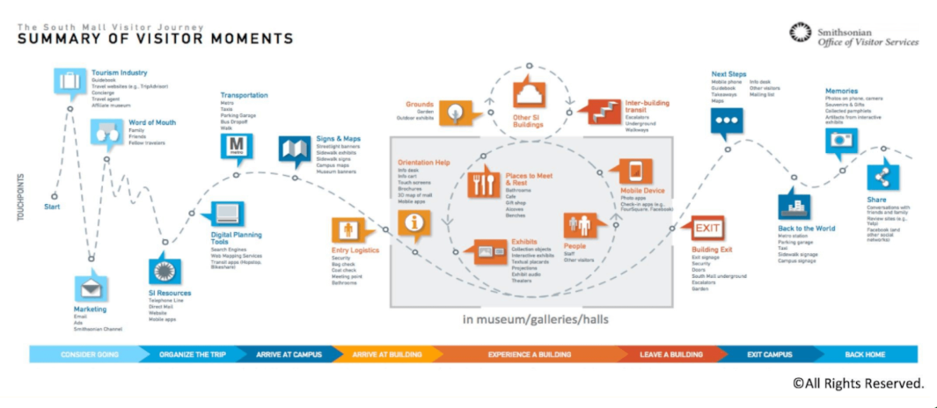
Visitor Summary flow
Op www.cap5.net free downloaad
Only fill in what is relevant for you. Modify template if needed.

Slide 41
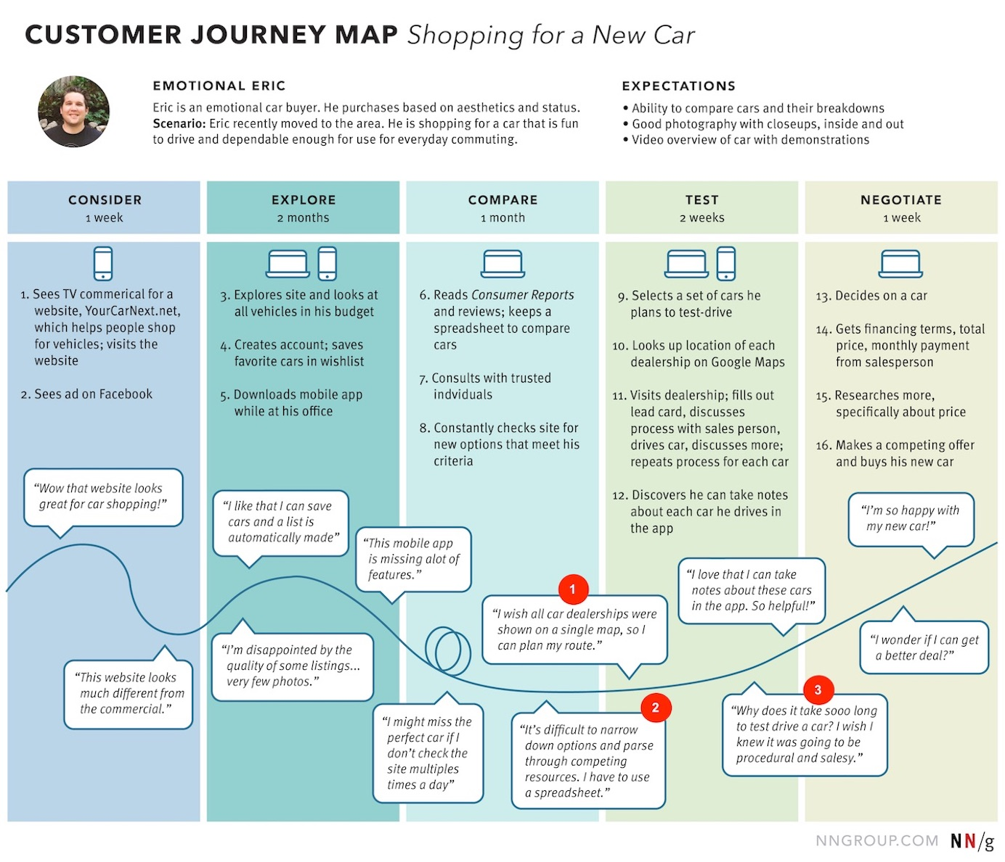
Visitor Summary flow
Op www.cap5.net free downloaad
Only fill in what is relevant for you. Modify template if needed.

Slide 42
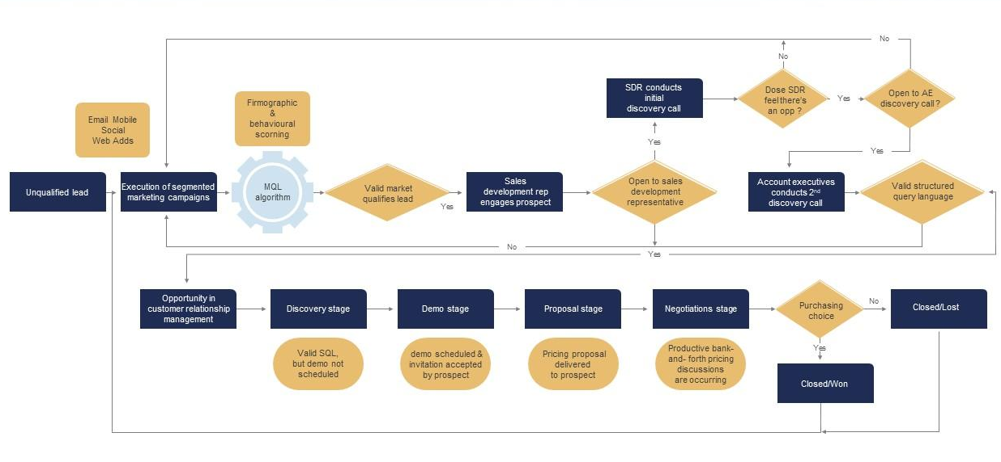
Sales & Marketing process flow, from lead to decision
Op www.cap5.net free downloaad
Only fill in what is relevant for you. Modify template if needed.

Slide 43
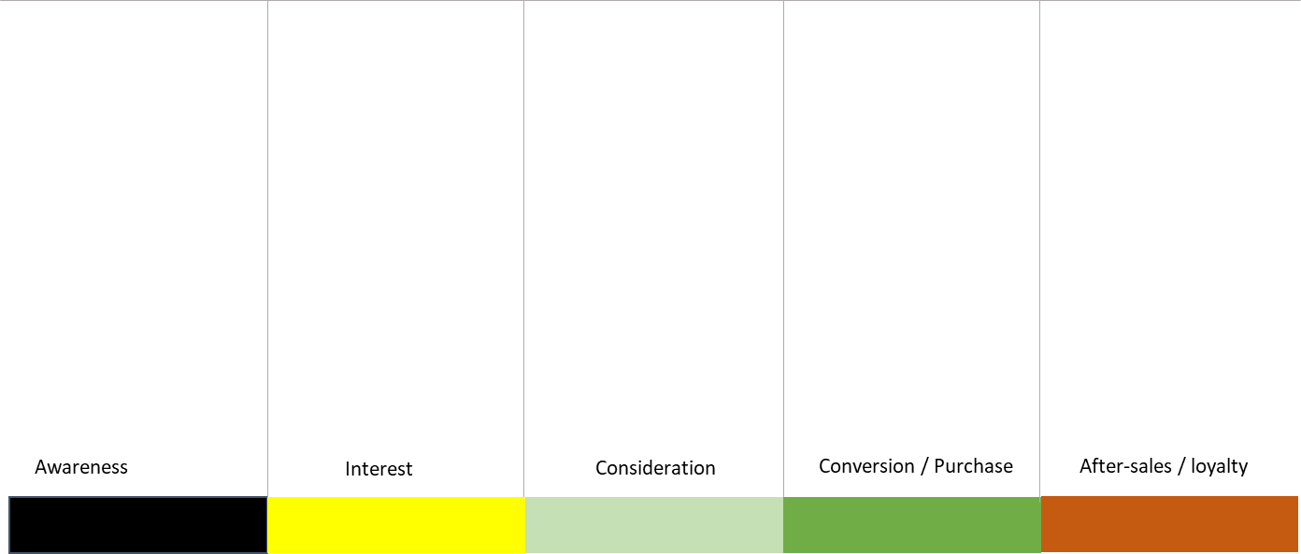
Content, trigger, CTA flow
Where can your Buyer Persona see you and communicate with you? See every moment through the eyes of a potential customer:
Does she or he have all the information?
Is it clear what you have to offer?
Do you describe the Pains and Gains well?
Does it come across as beautiful, pleasant and intuitive?
Do you use the language of this target group?
At what times is she or he ready to make a decision?
Op www.cap5.net free downloaad
Only fill in what is relevant for you. Modify template if needed.

Slide 44

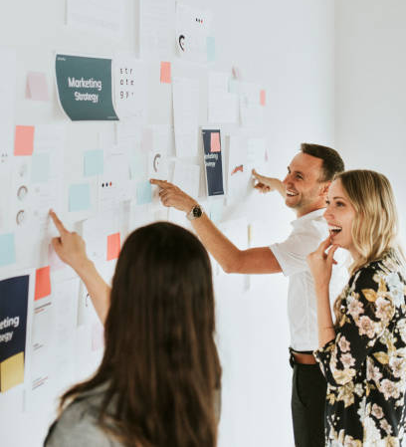
Content, trigger, CTA flow
PAINS
DESIRE
GAINS
Manageble
Critical
Urgent solution is needed
Nice to have
Op www.cap5.net free downloaad
Only fill in what is relevant for you. Modify template if needed.

Slide 45
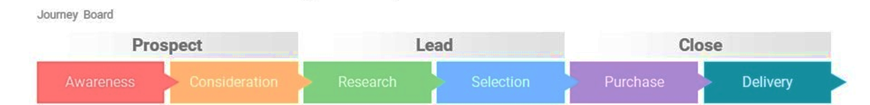
Go-to-Market, determine teasers, content and CTAs
Op www.cap5.net free downloaad

Slide 46
CAP5 Toolbox: tactical options thick-list
Excel free download on cap5.net
Op www.cap5.net free downloaad
These toolboxes can be modified and adjusted to your needs

Slide 47
Tactical options: choose your tactics – by stage
Op www.cap5.net free downloaad
These toolboxes can be modified and adjusted to your needs

Slide 48
Content per stage of sales funnel
 |  | Awareness | Interest | Consideration | Decision / Purchase | After sales - loyalty
Emotional | Your own content (or your property)
 | Content from an external source (curated / bought / free to share)
What inspires your target audience | Your own content (or your property)
 | Content from an external source (curated / bought / free to share)
Technical info | Your own content (or your property)
 | Content from an external source (curated / bought / free to share)
Scientific documents | Your own content (or your property)
 | Content from an external source (curated / bought / free to share)
Operational (productivity & efficiency improvement, possibility to improve, ..) | Your own content (or your property)
 | Content from an external source (curated / bought / free to share)
Testimonials & case studies, visuals of installations & projects | Your own content (or your property)
 | Content from an external source (curated / bought / free to share)
Visual storytelling | Your own content (or your property)
 | Content from an external source (curated / bought / free to share)
Conversie triggers & incentives | Your own content (or your property)
 | Content from an external source (curated / bought / free to share)
Op www.cap5.net free downloaad
Only fill in what is relevant for you. Modify template if needed.

Slide 49
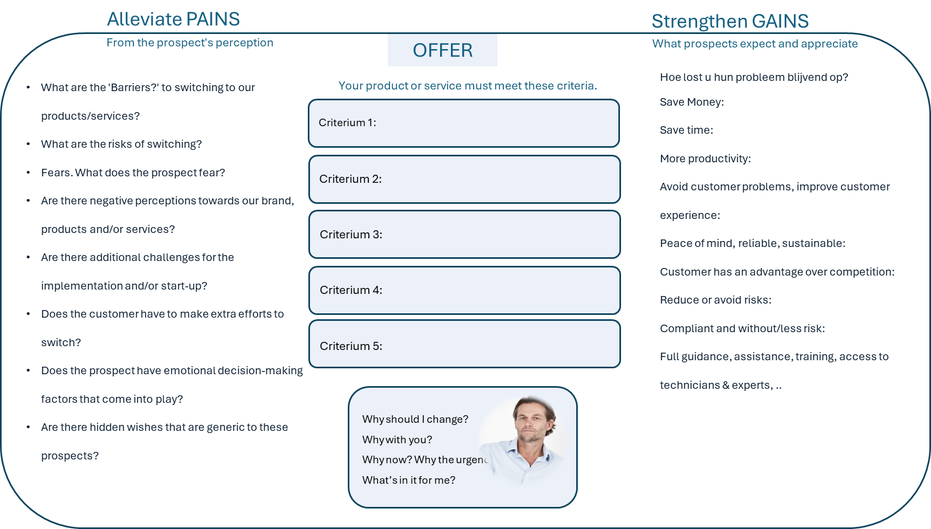

Exercise to mould your offer & criteria
Op www.cap5.net free downloaad
Only fill in what is relevant for you. Modify template if needed.

Slide 50
Tactical options: choose your tactics – inbound versus outbound
Op www.cap5.net free downloaad
These toolboxes can be modified and adjusted to your needs

Slide 51
PLANNING

Slide 52
Planning what to do before the launch
Op www.cap5.net free downloaad
These planners can be modified and adjusted to your needs

Slide 53
Campaign Planner
Op www.cap5.net free downloaad
These planners can be modified and adjusted to your needs

Slide 54
Monthly Recurring Tasks Planner
Op www.cap5.net free downloaad
These planners can be modified and adjusted to your needs

Slide 55
Annual overview work in progress
Op www.cap5.net free downloaad
These planners can be modified and adjusted to your needs

Slide 56

Checklist for Brand materials needed
Brand Identity Design |  |  |  | Brand Guidelines
(The “look and feel” that makes you recognizable) |  |  |  | (The “rulebook” so everything stays consistent)
Logo design | Multiple variations (full, icon, monochrome). | Multiple variations (full, icon, monochrome). |  | Brand style guide (PDF or online) covering:
Color palette | Primary and secondary colors with usage rules. | Primary and secondary colors with usage rules. |  |  | Logo usage (dos and don’ts) | Logo usage (dos and don’ts)
Typography | Heading, body, and accent font families. | Heading, body, and accent font families. |  |  | Color codes (RGB, HEX, CMYK, Pantone) | Color codes (RGB, HEX, CMYK, Pantone)
Visual language | Patterns, shapes, textures, and style elements. | Patterns, shapes, textures, and style elements. |  |  | Typography rules | Typography rules
Imagery guidelines | Photography, illustration, icon styles. | Photography, illustration, icon styles. |  |  | Photography and iconography style | Photography and iconography style
Tone of voice | How the brand speaks in text and speech. | How the brand speaks in text and speech. |  |  | Tone of voice examples | Tone of voice examples
Tagline / slogan | Short memorable phrase. | Short memorable phrase. |  |  | Example layouts for marketing assets | Example layouts for marketing assets
Brand story | A narrative that emotionally connects. | A narrative that emotionally connects.
Design mockups | e-mail headers, business cards, website header, packaging, | e-mail headers, business cards, website header, packaging,
Brand Collateral & Marketing Assets
(Practical tools for launch and sales) |  | (Practical tools for launch and sales)
Business cards & stationery | Letterhead, envelopes, email signatures. | Letterhead, envelopes, email signatures.
Pitch decks & sales presentations | Branded templates & fact sheets for sales teams. | Branded templates & fact sheets for sales teams.
Brochures, flyers, product sheets | Print and digital formats. | Print and digital formats.
Social media kit | Profile & cover images, post templates, highlight covers. | Profile & cover images, post templates, highlight covers.
Website design | Homepage, product/service pages, brand storytelling page. | Homepage, product/service pages, brand storytelling page.
Packaging design | Boxes, labels, product inserts (if physical goods). | Boxes, labels, product inserts (if physical goods).
Op www.cap5.net free downloaad
These toolboxes can be modified and adjusted to your needs

Slide 57
Customer touchpoints per stage (see sales funnel)
 |  | Awareness | Interest | Consideration | Conversion / Purchase | Upscale, cross-sell
Emotional | Self-made or own content
 | External source content: Curated or purchased
What inspires your target audience | Self-made or own content
 | External source content: Curated or purchased
Technical info | Self-made or own content
 | External source content: Curated or purchased
Scientific documents | Self-made or own content
 | External source content: Curated or purchased
Operational (productivity & efficiency improvement, possibility to achieve, ..) | Self-made or own content
 | External source content: Curated or purchased
Testimonials | Self-made or own content
Visual storytelling | Self-made or own content
Conversie triggers & incentives | Self-made or own content
 | External source content: Curated or purchased
Op www.cap5.net free downloaad
Only fill in what is relevant for you. Modify template if needed.

Slide 58
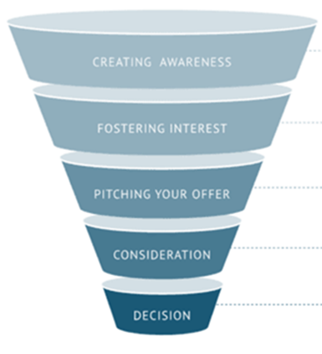
Customer touchpoints per stage (see sales funnel)
Sector magazine articles
Blits media scoop
Youtube video’s
Influencer video’s
X & LinkedIn teasers
X & LinkedIn invies webinars
Buy now incentives
Free Pilot or Proof-of-Concept
Money-Back Guarantee
Pay-on-Results
Free migration / installation
Free staff training
Invite webinars
Send links video’s
Send Spces
Send fact sheets
Deferred payment
Rental, first 2 months free
Leasing including free quarterly maintenance
Digital Touchpoints
AWARENESS
INTEREST
MAKE OFFER
CONSIDERATION
DECISION
Physical Touchpoints
Stand Sector Fairs
Sector events
Schedule conf calls
Schedule call with engineers / presales
Use customers to make introduction
Sales visit
Physical demo
On site test
Sales & engineer visit
CEO or CTO visit
Op www.cap5.net free downloaad

